Slide 1

Phylogenetic trees across algorithms
A presentation by Liz Wyman, Kleo Bano, Roberto Rivas, and Chris Troyer

Slide 2
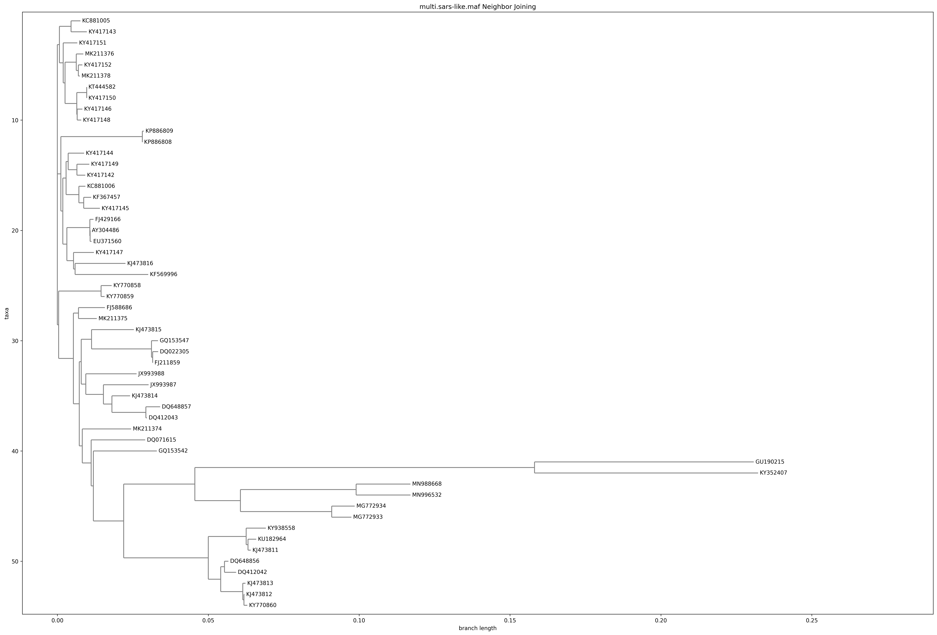
Neighbor joining - multiple SARS strains

Slide 3
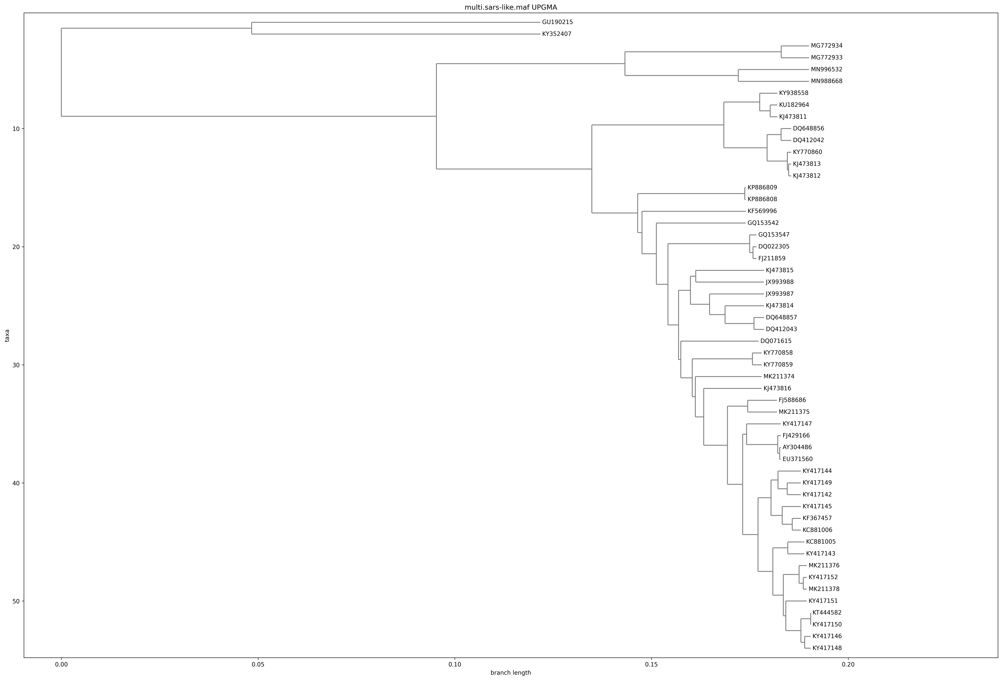
UPGMA – multiple SARS strains

Slide 4
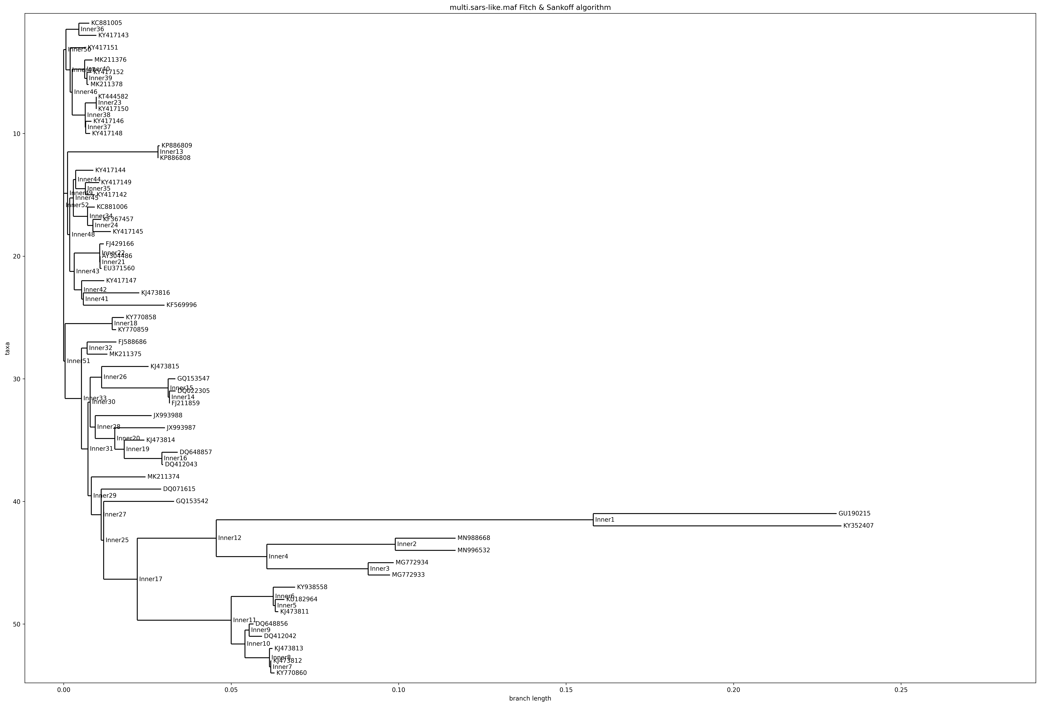
Parsimony – multiple SARS strains

Slide 5
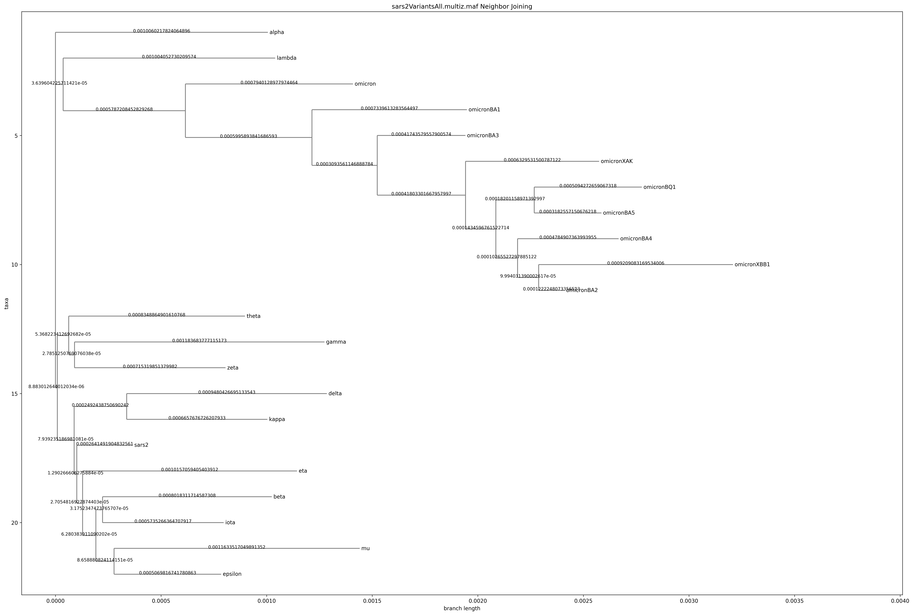
Neighbor joining – SARS-COV-2 variants

Slide 6
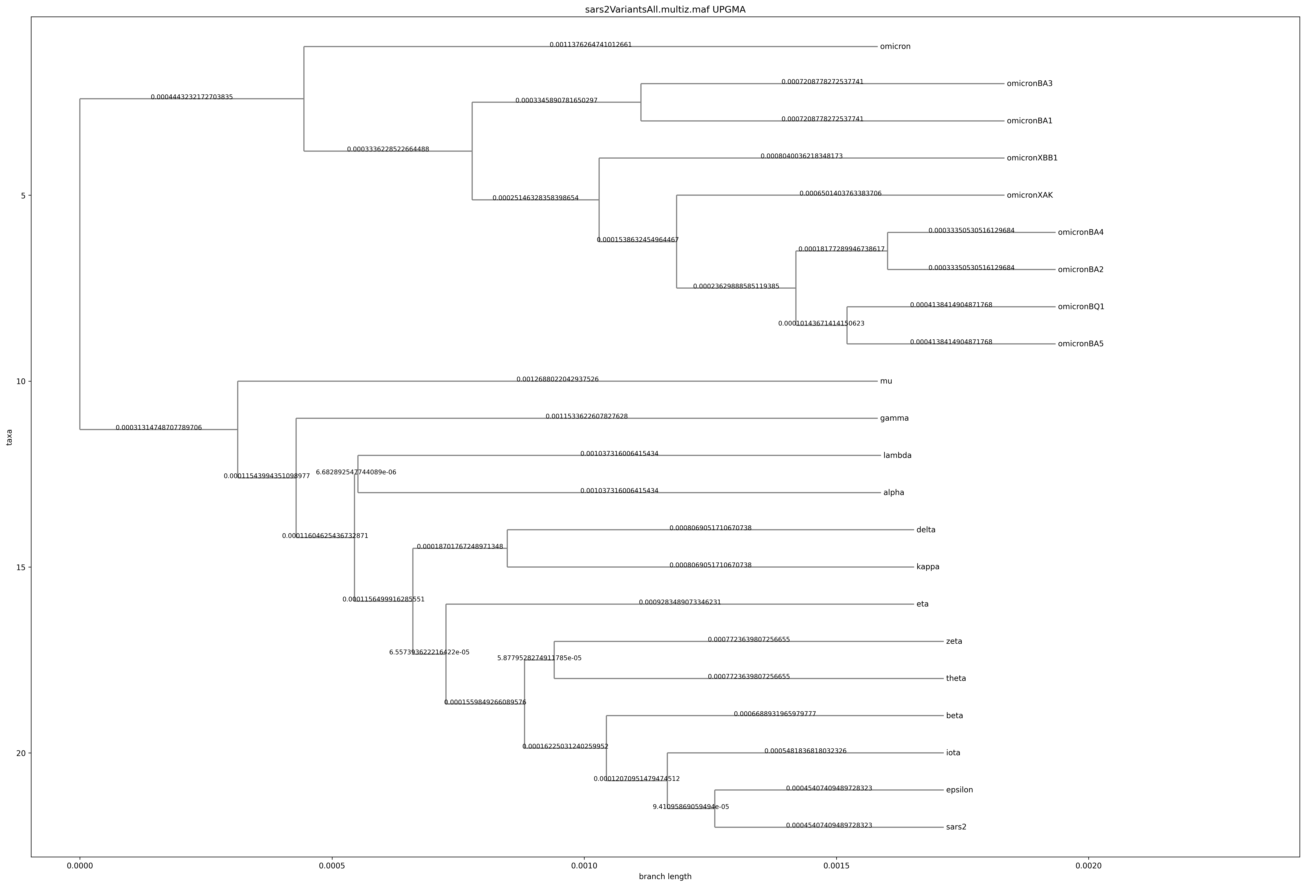
UPGMA – SARS-COV-2 variants

Slide 7

Parsimony – SARS-COV-2 variants

Slide 8
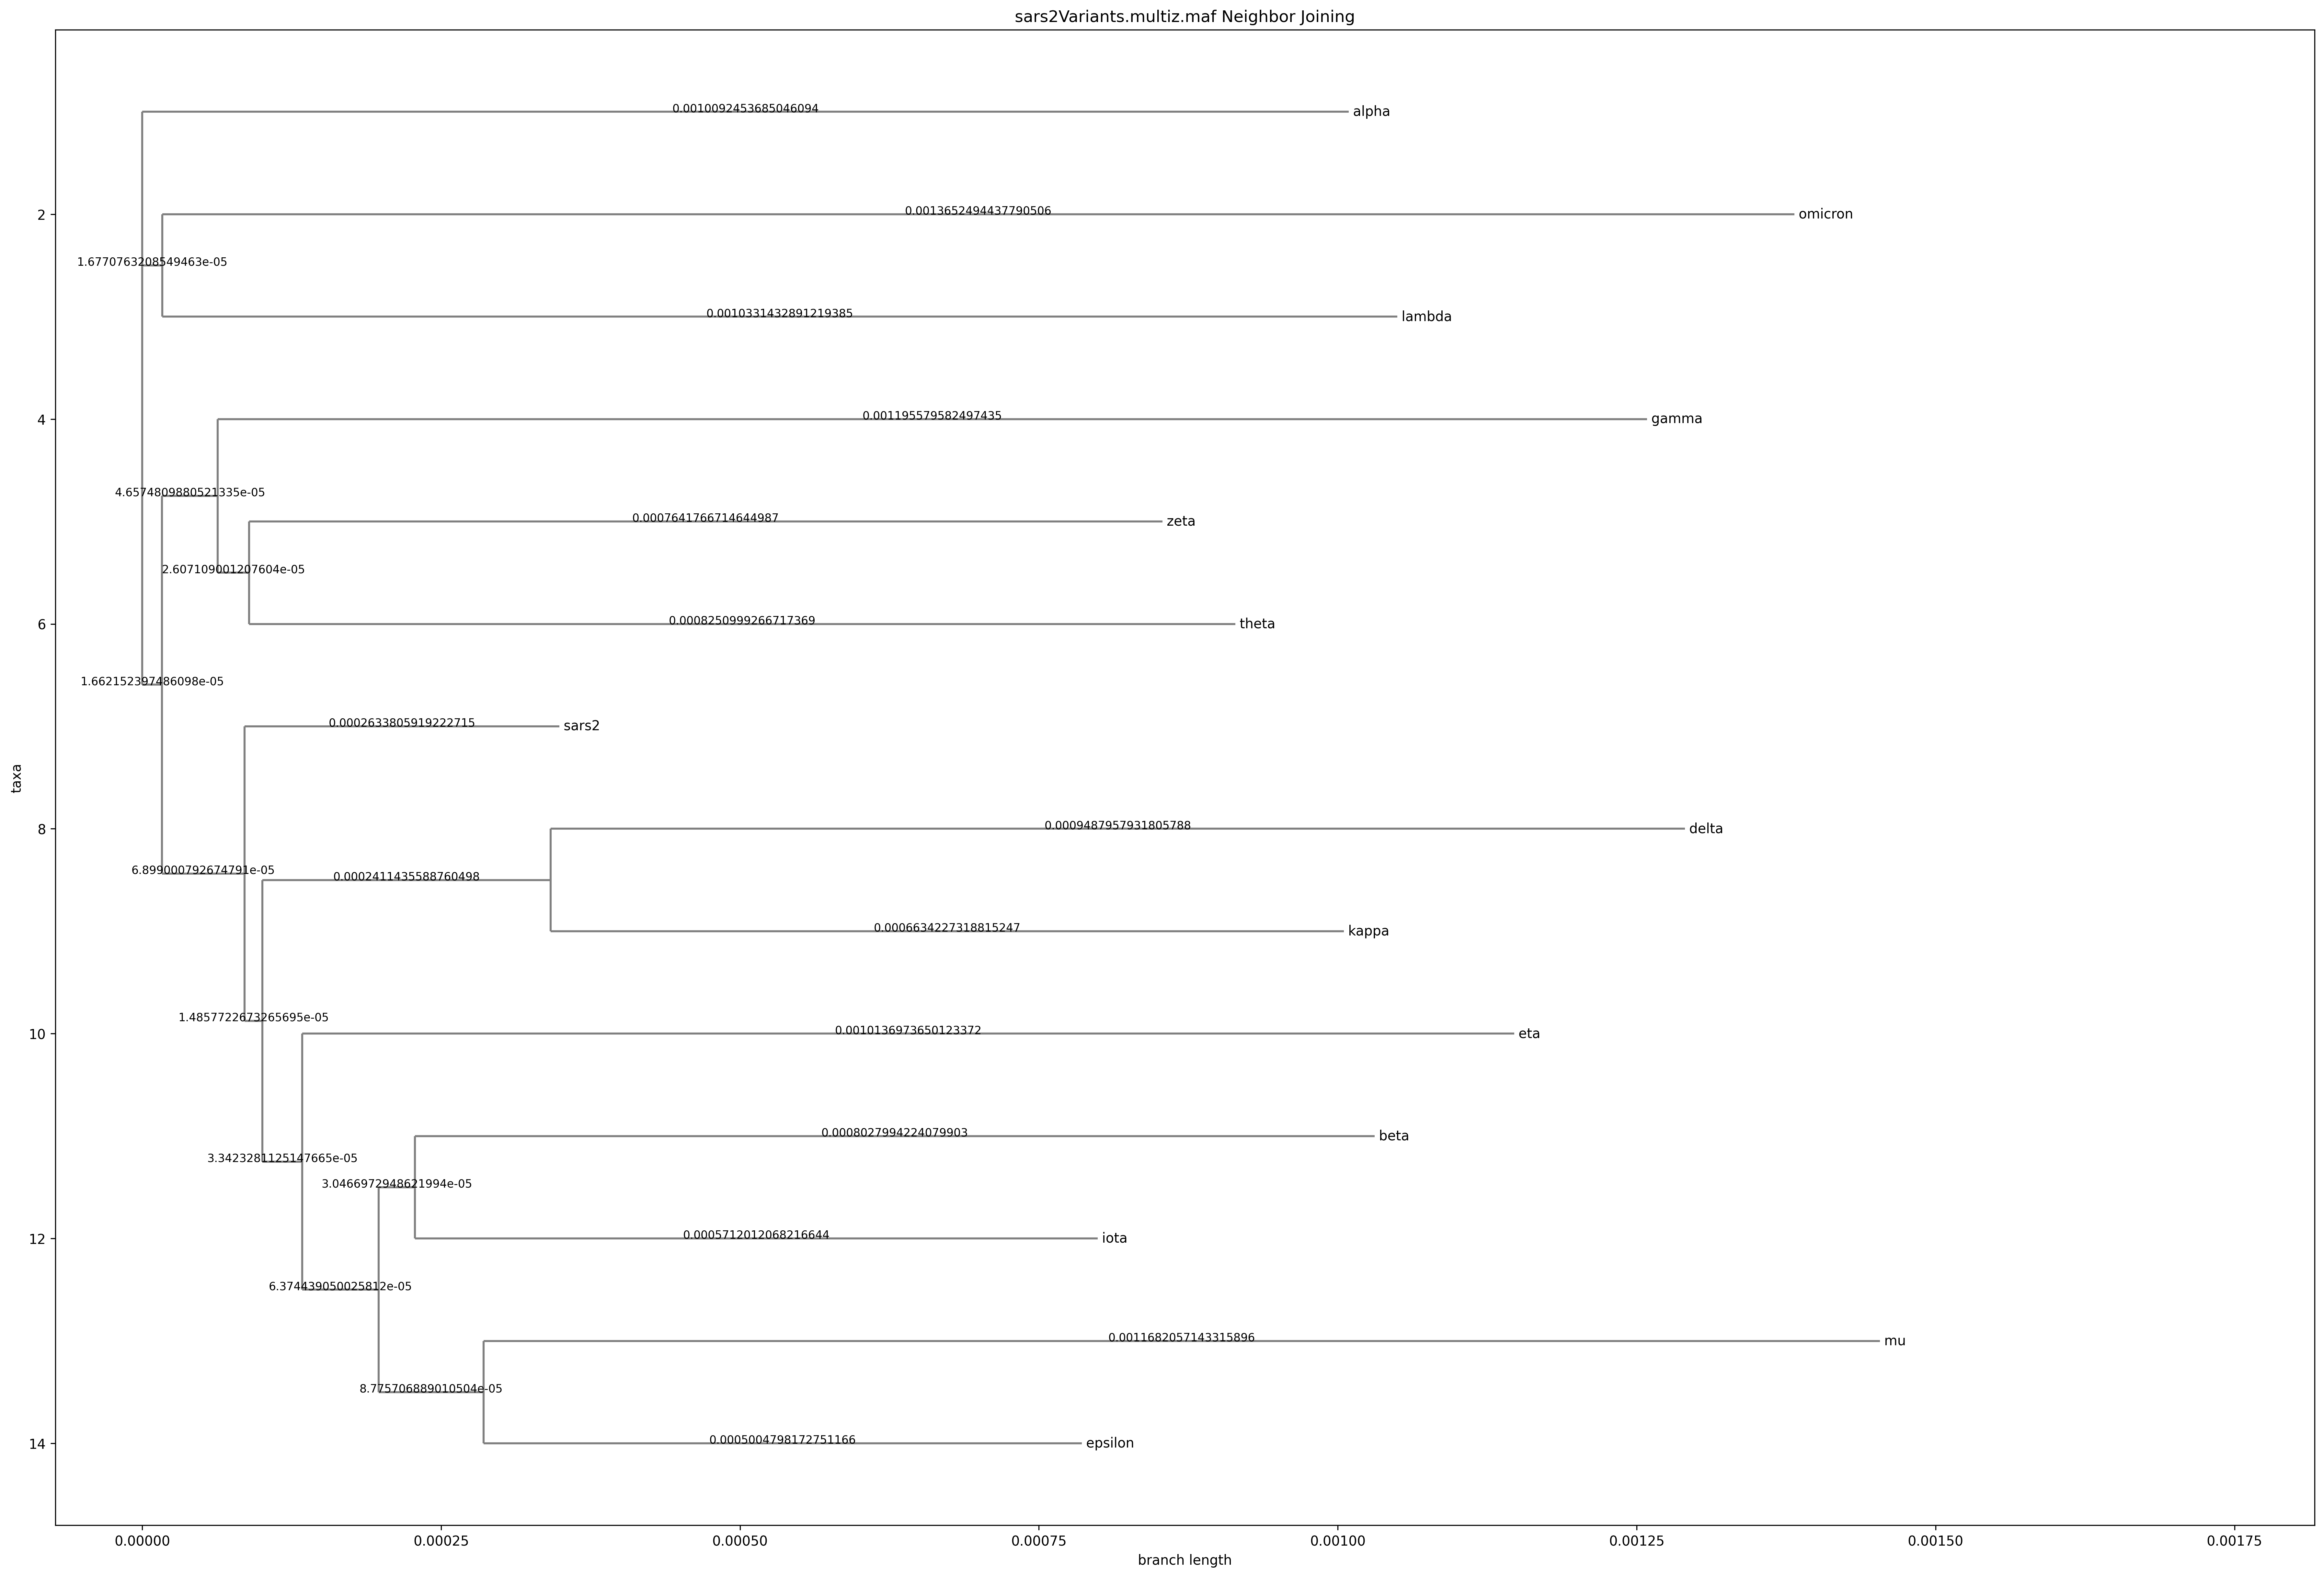
Neighbor joining – SARS-COV-2 variants w/o omicron variants

Slide 9
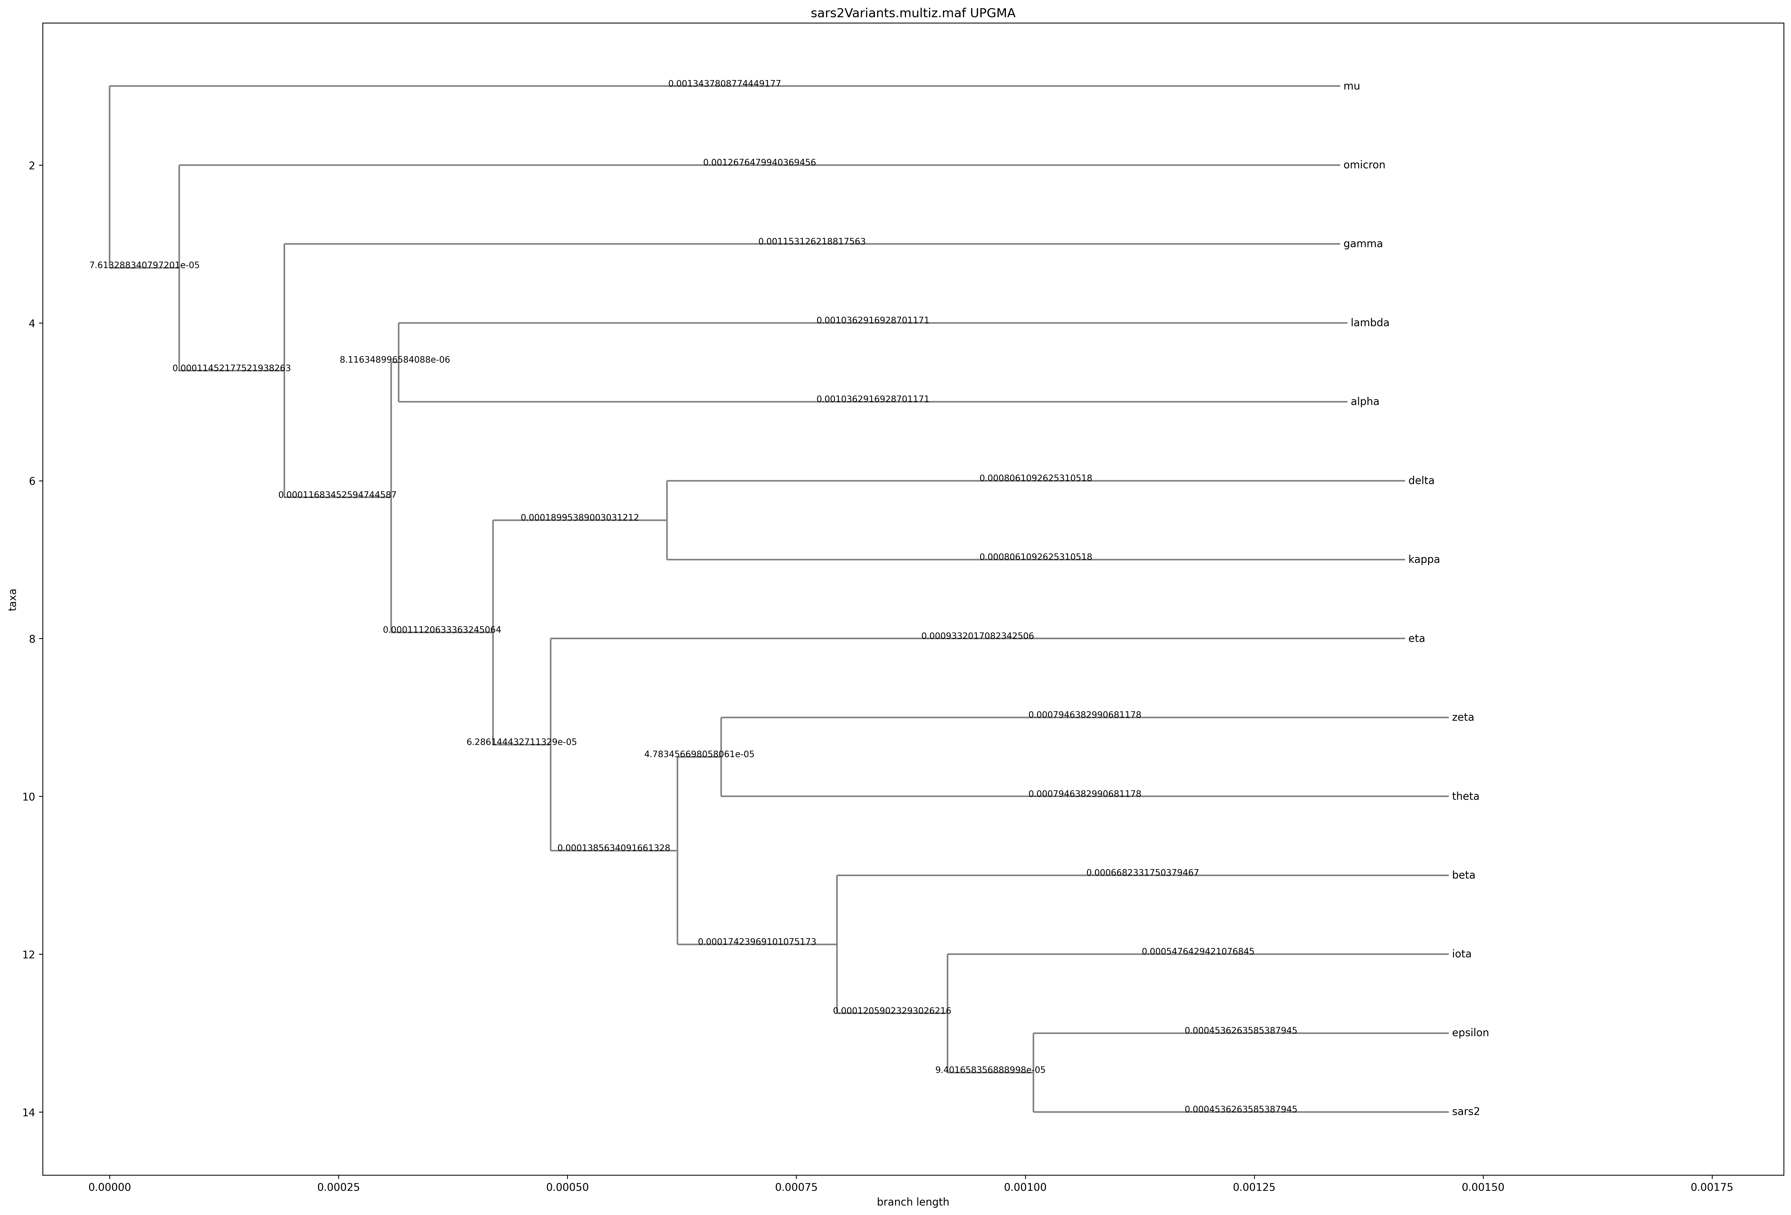
UPGMA– SARS-COV-2 variants w/o omicron variants

Slide 10
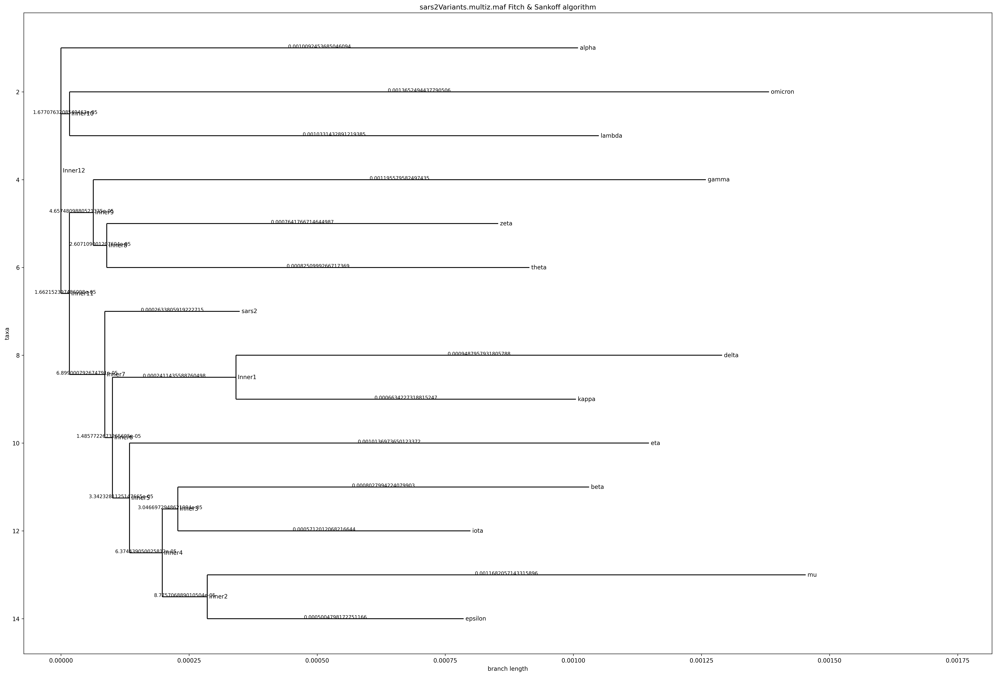
Parsimony – SARS-COV-2 variants w/o omicron variants

Slide 11
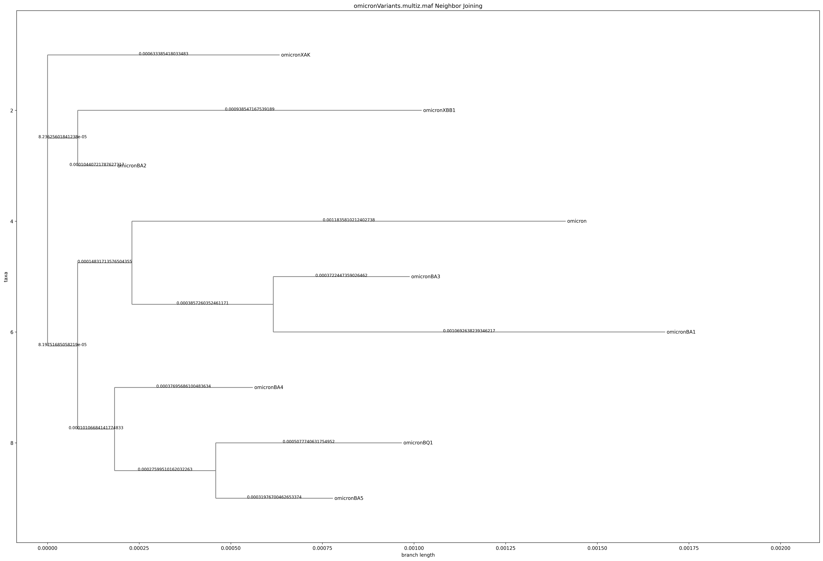
Neighbor joining – omicron variants only

Slide 12
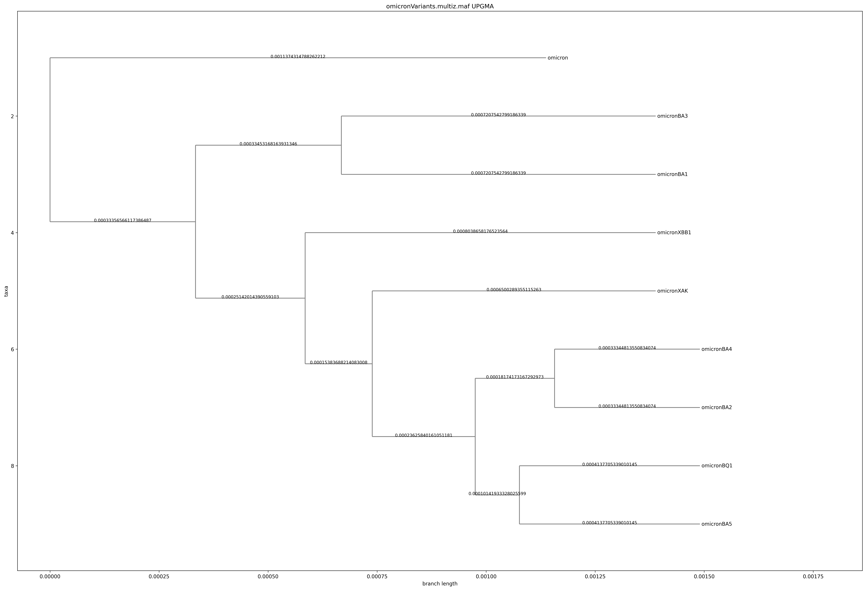
UPGMA – omicron variants only

Slide 13
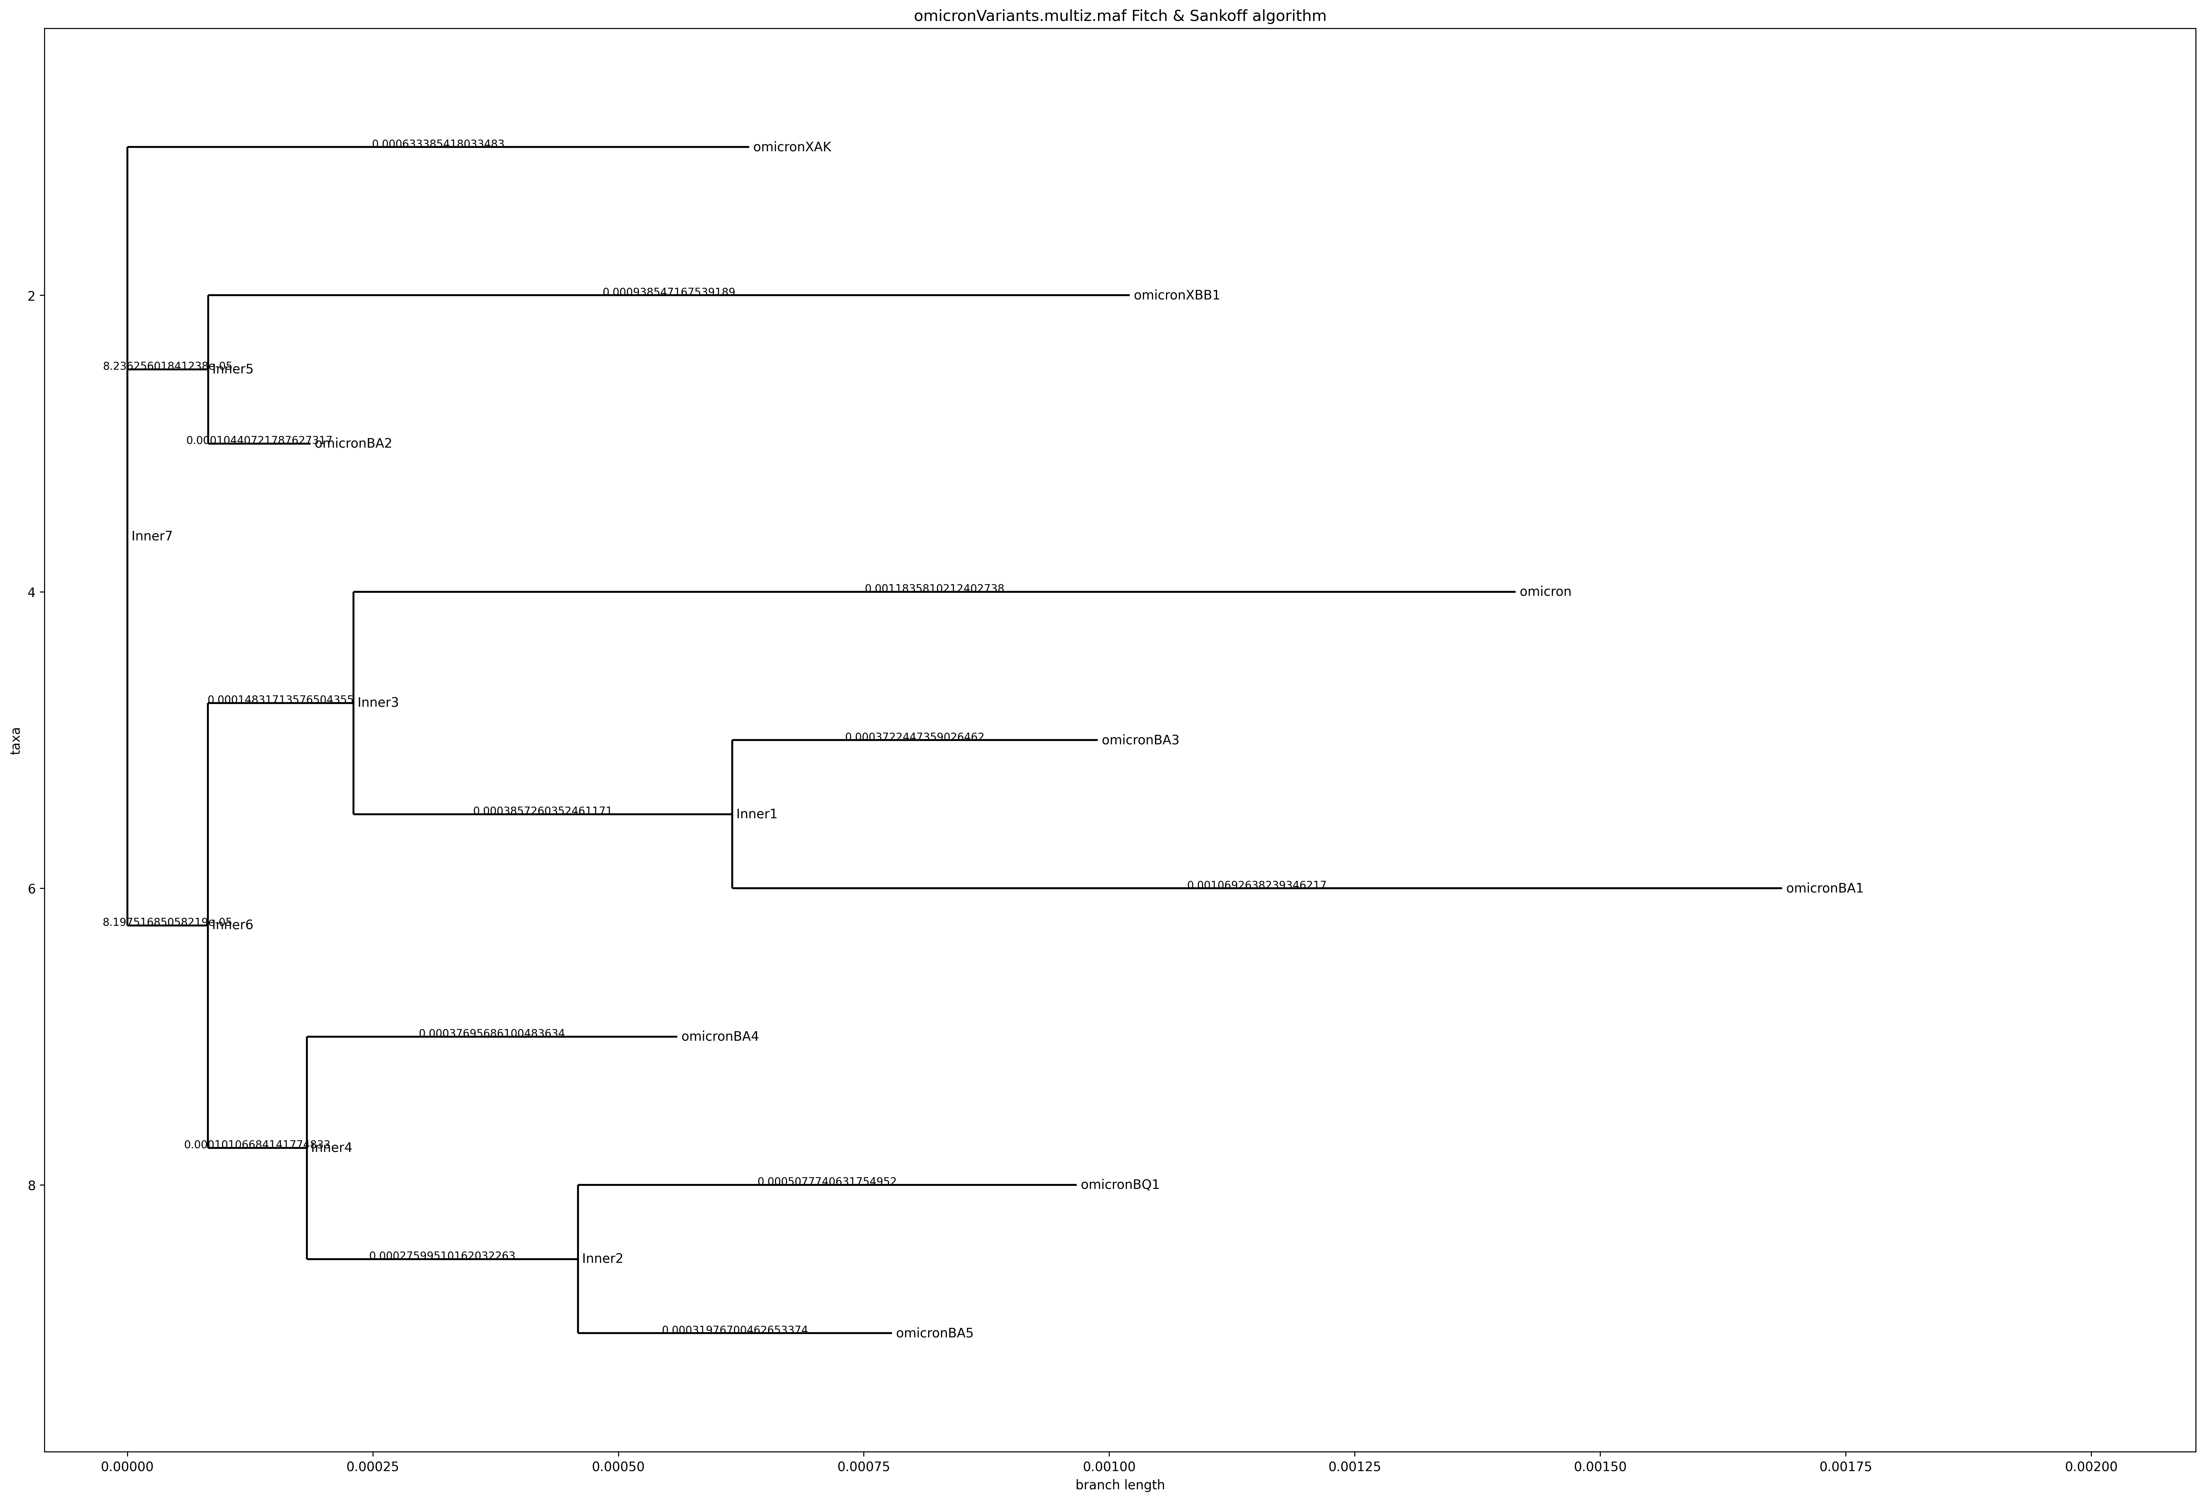
Parsimony – omicron variants only

